Slide 1
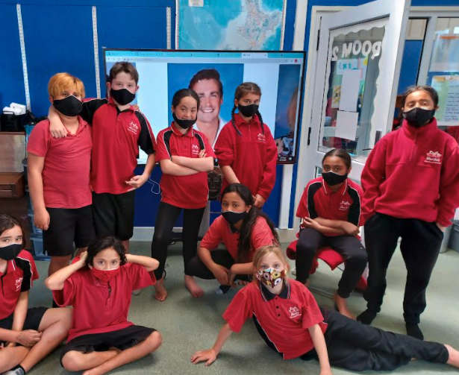
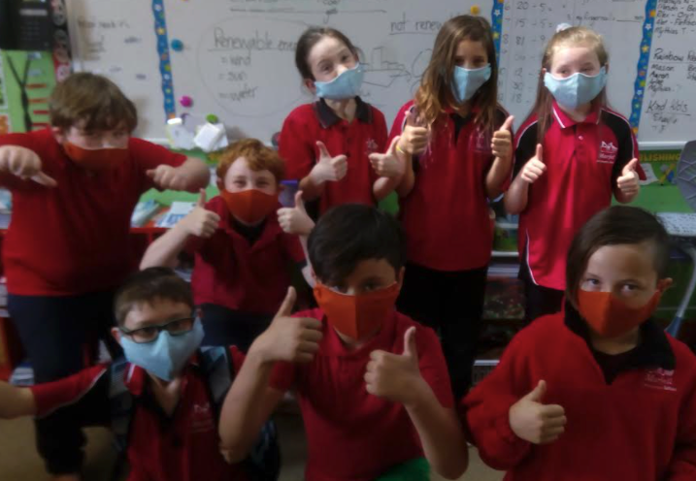
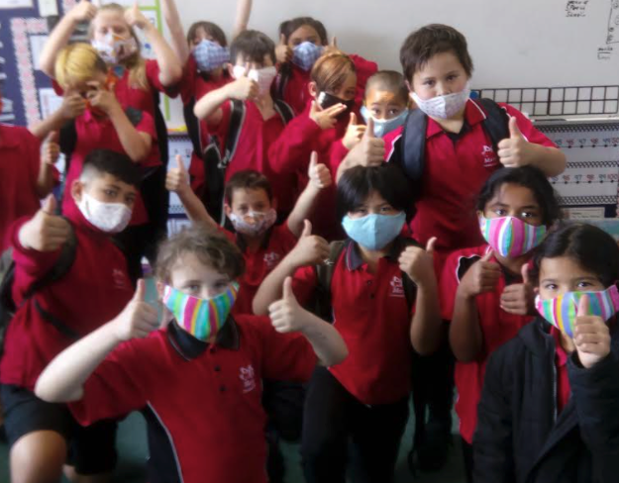
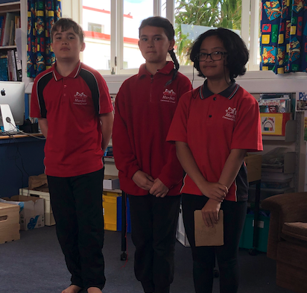
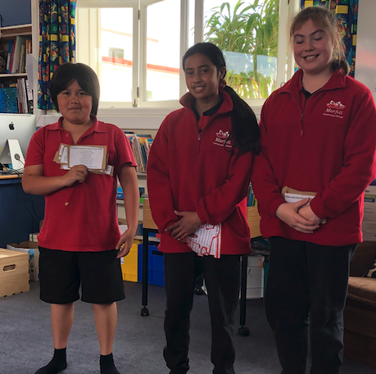
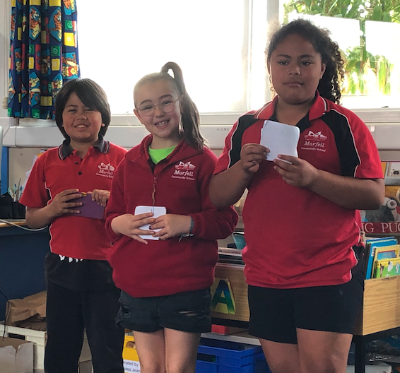
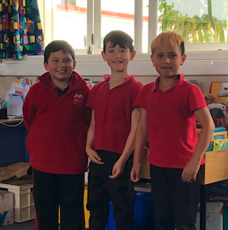
What’s happening at Marfell?
Week 4 Term 4 2021
MANA Leaders
Kia ora, Talofa lava, Kia orana, Fakalofa lahi atu, Mabuhay, Saludos para ti, Bula vinaka.
It seems summer has finally arrived with some beautiful hot weather and glorious days. With this in mind we have decided to open the school pool for lessons and lunchtime swims. This will begin Monday 15th of November and will keep us all cool and refreshed!
Above: Mrs Steenson, Wendy Darling, Jeannie Harwood, Lorna Fawlkner and friends have all worked together to make these beautiful 3 layer masks for children and whanau. Many children took one for dad saying that “Dad keeps taking Mums!” Thank you to all these people for this amazing effort.
School Speeches
Last week we held the finals for the school speech competitions. Due to COVID restrictions we held these in year levels in the library.
PROTECTING OUR TAMARIKI, STAFF, & COMMUNITY
Auckland and parts of Waikato are at Alert Level 3. Alert Level boundaries are in place around these areas. Travel into, out of, through or within different Alert Levels is highly restricted. That is to minimise spread of the virus.The rest of New Zealand is at Alert Level 2.
Do not travel unless it is absolutely necessary. Attempting to cross a boundary without permission is an offence.
If your whanau have crossed Alert Level Boundaries into Auckland or Waikato, we will need to take a precautionary approach before your child’s return to school to minimise a potential high impact within our school community.
Please contact the office before your child returns to school to complete a risk assessment. Keep our community safe.
Coming Events and Dates to Note
Fridays or Sundays
Indoor Netball - times to be advised.
Wednesday 27 October - 8:30 - 11:30 & every Wednesday
COVID Pop-up Clinic @ Koru House
Monday 13 November
School Pool Opens
Year 6
1st Tyler O’Regan - Sports
2nd - Frauline Mula - Marine Life and Whaling
3rd - Nevaeh Berry
Why we need an indoor netball hoop.
Year 5
Ist = Princel Tui-Tako - Coral Reefs
1st = Maia Vedder - Plastic Pollution is Bad.
2nd - Leyana Hunia - COVID 19.
Year 4
1st - Estefy Ferro-Pires - Axolotls
2nd - Shaolin Tako-Tui - Penguins
3rd - Sienna Ruakere - Octopuses
Year 3
1st - Deekyn Tuhua Clark - Exotic Animals
2nd - Raven Urlich - 2d and 3D
3rd - Jeffery Mann - Prodigy
Room 6 Presenting their poems. They learnt - Spring, This is Me and Guy Fawkes.

Slide 2
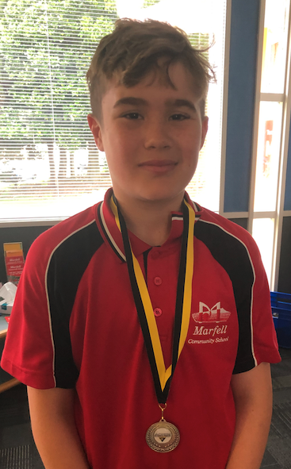
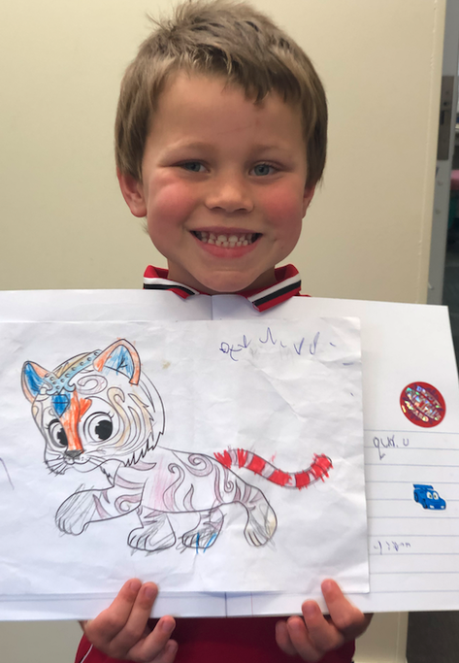
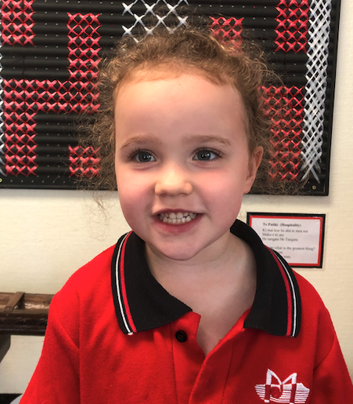
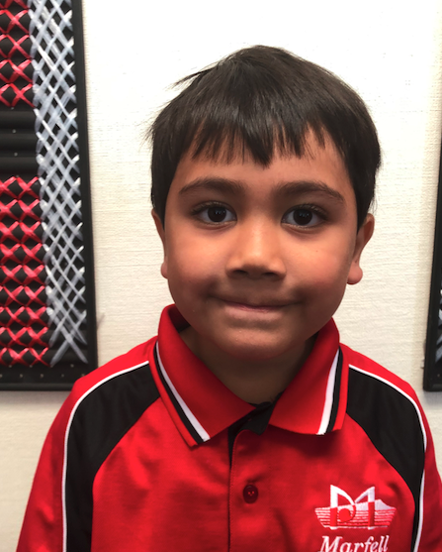
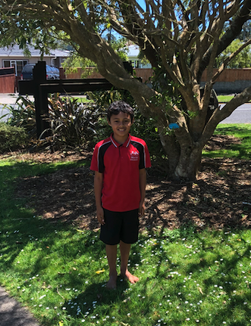
Great Achievements
Welcome to....
A very warm welcome to Lilley Bridger and Hohaia Pouha. Both Lilley and Hohaia are 5 years old and are in Room 7. They have settled in extremely well and have made some lovely friends.
VERY Warm Weather
Happy Healthy Learners Certificates
Room 1: Louie Niwa, Deekyn Tuhua-Clark
Room 3: Kitana Manu, Zoey Berry, Bryher Cameron, Paris Julian
Room 4/5: Chase Thomson, Vann Cleaver, Henry Tongi
Room 6: Andrena Niwa,
Room 7: Bonnie Manu
Room 12: Keiara Bunyan, Hayley Ford, Aaliyah Armstrong, Darious Parker, Reef Smith-Harriman,
MANA Certificates
10 Points: Crewso Kaumoana-Falconer, Darious Parker, Reef Smith-Harriman,
20 Points:
30 Points: Keiara Bunyan, Princel Tako-Tui
40 Points: Alexis Anderson, Daniel Ruakere, Starlya Thomson, Kordel Wetini,
50 Points: Maia Hotene, Adedas Bunyan, Brooklyn
Harrington, Auron Tako-Bibby, Daniel Ruakere, Xavier McGregor, T.J Urlich, Kaiahn Weston, Aaliyah Armstrong, Gabby Edwards, Devynn Julian
75 Points: Eli Mackay, Louie Niwa, Zoey Berry, Estefy Ferro Pires, Maia Vedder, Frauline Mula
Caught Being Good
Room ⅘: Harshit Koyya,
Room 6: Mason McEntee, Shelby Wetini
Room 7: Sante Ferro-Pires, Armani Bunyan, Zeke
Rogers
Room 8: Cliff Awa, Edison Elliot-Nicholas
Room 1: Crewso Kaumoana-Falconer, Daniel Ruakere
Room 3: Bobby Lander, Phoenix West,
Room 12: Darious Parker, Reef Smith-Harriman,
Indoor Netball
Player of the Day: Lochi Corp, Tyler O’Regan, Riddick Vedder
Most Improved: Nevaeh Berry
100% Attendance Term 3
Jeffery Mann, Lochi Corp, and Kaylah Corp. These children will be going to Sushi Ninja next week!
COVID Vaccination Clinic
A COVID vaccination clinic will be running from the Marfell Community Trust building for the next six weeks. This will be held Wednesday mornings. Please take advantage of this opportunity if you require a vaccine.
Have a great and wonderful week!
Tyler O’Regan and Lochi Corp were selected for the Taranaki Rep team for Indoor Netball.
They both played in the tournament last weekend. Tyler’s Team were Runners-up (out of a lot of teams.
Well done to both of you on this amazing achievement.
Mason McEntee has been doing some awesome work in class and has made it into the Beehive several times. Well done Mason - Keep up the great work!
Now that the weather is so warm we are asking for children to take their jerseys off in the mornings - once the morning chill is gone.
Kordel is modelling a very sensible summer attire for the weather.
Check out Facebook for more updates!

